Slide 1
Computational Storage
DEMO 2 · 10 / 21
A working prototype and its separate-compute baseline
Aakash, Harshada, Ivan, Jeehan, Mason
Notes:
Hi everyone, we're the Computational Storage team. Last time, we proposed running data preprocessing on the machines where the data is stored, instead of shipping the data to separate compute machines. Today we'll show you the working prototype, and the baseline we measured it against.

Slide 2
Why computational storage?
Recap from Demo 1: preprocessing moves data twice
Separate
DROID, RLDS → LEROBOT
1.7 TB → ≈ 400 GB
Storage
input
Compute
ƒ
input and output sizes in Hugging Face's porting guide
output
GOAL IN THE PROPOSAL
Combined
≈ −70%
Storage + compute
ƒ
local read → process
network bytes,
with runtime no worse than the baseline
Notes:
A quick recap of the problem. Normally, preprocessing a big dataset means copying it from storage to a compute machine, processing it there, and then copying the result back. So the data has to crosses the network twice.
For our example we'll be using DROID, a large robot learning dataset. Its published version is about 1.7 terabytes, and converting it to the LeRobot format produces about 400 gigabytes. Our idea is to run that conversion on the storage machine itself. The goal in our proposal was to cut network traffic by about 70 percent, without making it any slower. For Demo 2, we had to build the system and measure the normal way first.

Slide 3
Demo 2 milestone
As committed in the design proposal: all four parts are done
DONE
Single-node Ceph cluster
EXPERIMENT 01
MicroCeph (Ceph 19.2): 1 mon, 1 mgr, 1 mds, 3 OSDs; CephFS mounted on both nodes
DONE
Load → convert → write-back
EXPERIMENTS 02–05
Real DROID 1.0.1 shards, Hugging Face's converter unmodified, verified output
DONE
Background conversion service
EXPERIMENT 06
Converts newly loaded data with no manual step
DONE
Separate-compute baseline
EXPERIMENTS 03, 07
797 MB across the network and 304 s per shard, reproduced in a second run
Also measured: the same jobs run on the storage node, compared against the baseline (results on slides 8–9)
Notes:
Here's what we promised for Demo 2, and all four parts are done.
First, a Ceph storage cluster running on one machine.
Second, the full path: load the data, convert it, and write the result back.
Third, a background service that converts new data automatically.
And fourth, the baseline. We ran the conversion on a separate compute machine and measured it.
For one shard, which is one 649-megabyte piece of the dataset, it moved 797 megabytes over the network and took 304 seconds. We also ran the same job on the storage machine, and we did the whole comparison twice on fresh AWS machines, with matching results.

Slide 4
What changed since Demo 1
From the proposal to a running system
 | DEMO 1: PROPOSED | DEMO 2: BUILT
Storage | Ceph on Kubernetes with Rook | Single-node MicroCeph + CephFS; Rook arrives with multiple nodes in Demo 3, as planned
Interface | Function, inputs and dependencies | A job is a function, its declared input files and an output directory; Demo 3's placement reads the input list
Workers | Containers beside storage, with limits | One pinned image on both nodes: 7 CPUs, 8 GiB, no network inside
Workload | RLDS → LeRobot with Hugging Face's converter | port_droid.py v0.6.1, unmodified, on real DROID 1.0.1 shards
Measurement | Cross-host bytes and end-to-end time | NIC counters, cold caches, and a byte-level comparison of the outputs
Notes:
Here's how the proposal turned into a real system.
For storage, we started with Ceph on a single machine, using MicroCeph.
For the interface, each job is three things: the function to run, the files it reads, and the folder it writes to.
For the workers, every job runs in the same container with the same limits: 7 CPUs, 8 gigabytes of memory, and no network access inside. For the workload, we run Hugging Face's own converter, on real DROID data.
Finally, to measure, we count the bytes that cross the network, then we clear the caches before every run, and compare the two outputs

Slide 5
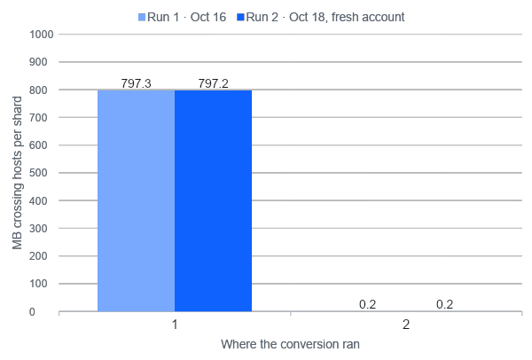
Result: network traffic
Shard 2, two independent runs; same image, limits and cold caches in both modes
−99.97%
cross-host traffic vs. the baseline
Baseline: 797.3 and 797.2 MB, which is 1.01 × (input + output): the shard is read once and its output written back once
Storage node: 0.2 MB in both runs, ssh and CephFS session traffic
PROPOSAL GOAL ≈ −70%
RUN 1 demo2-20261016-210744
RUN 2 demo2-20261018-184414
Notes:
This is our main result. The left pair of bars is the baseline: running the conversion on a separate machine moved 797 megabytes over the network. That's almost exactly the input plus the output, because the data is read once and the result is written back once. The right pair is the same job running on the storage machine. It moved only 0.2 megabytes. That's just background traffic, like our remote login session and Ceph's own housekeeping. So that's 99.97 percent less traffic, and our goal was 70 percent. We ran everything a second time on a brand-new AWS account, and got 797.2 and 0.2 megabytes again.

Slide 6
Testbed
Two EC2 m6i.2xlarge in one subnet, with the same worker image and limits on both nodes
Compute node
Storage node
BASELINE: SEPARATE MODE
MICROCEPH · CEPH 19.2
CephFS client
NETWORK
Ceph + CephFS
/mnt/cephfs, same paths as storage
separate mode: shard read, output written back
mon · mgr · mds · 3 OSDs · 3× replication
Worker container
Worker container
port_droid.py · 7 CPUs · 8 GiB · no network
cross-host bytes = the storage node's NIC rx + tx
storage mode: same image, same limits
Local scratch for the converter's temp files
cstore-service: converts newly loaded data
runs the experiments, drops caches, reads NIC counters
DROID shards loaded from Google Cloud Storage, MD5-checked
Notes:
Here is our test setup, we used two identical machines on AWS. On the right is the storage machine. It runs Ceph, which stores the data and shares it as a normal folder. On the left is the compute machine, which opens that same folder over the network.
Both machines have the same worker container.
In the baseline, the worker runs on the compute machine, so the data is read over the network, and the result is written back over the network.
In our approach, the same container runs on the storage machine, right next to the data. Every byte that travels between the two machines has to go through the storage machine's network card. So we measure traffic by reading that card's byte counters before and after each job.

Slide 7
How one job runs
One DROID shard in, one LeRobot dataset out (times measured on shard 2)
01
02
03
04
Job spec
Convert
Publish
Verify
Function, declared input files, output directory
Reads the shard from CephFS, writes to local scratch
Copy and fsync onto CephFS, then one atomic rename
LeRobot's loader; frame counts across data and 3 videos
jobs.py
301 s
0.8 s · 141.5 MB
39 / 39 episodes
DESIGN DECISIONS
Reuse the converter unmodified
Same container in both modes
Publish atomically
Hugging Face's port_droid.py, verified by checksum before every run, so where it runs is the only thing that changes.
Same image, CPU and memory limits, and no network inside: every byte goes through CephFS, where we count it.
The service and other readers never see a half-written dataset, and a dataset is either complete or absent.
Notes:
Here's what happens in one job. It starts with a job spec. Then the worker runs Hugging Face's converter, which took 301 seconds on our test shard. Next, we copy the result onto Ceph and make it appear all at once with a single rename, so nobody ever sees a half-written dataset. That took about one second. Finally, we check the output with LeRobot's own loader.
One problem we hit, the public DROID files are missing six fields that Hugging Face's converter needs, so our first real run crashed. We fill in those fields ourselves, using the file path for the lab and the date, and placeholder values for the rest. That way the converter itself stays unchanged.

Slide 8
Background conversion service
Newly loaded data is converted with no manual step (demo video)
1
Shard loaded
SERVICE LOG AND VERIFICATION · AWS RUN 2, 2026-10-18
bin/cstore load-droid writes it to CephFS
18:54:53 queued svc-shard-00002
new shard 2 has no converted output
18:54:54 running droid_rlds_to_lerobot
18:59:46 finished wall 292.5 s · 141.5 MB
VERIFY OK · 39 episodes · 9,829 frames
2
Service notices it
no LeRobot output yet → a job in queue/pending/
3
Claimed and run
atomic rename into running/, then a worker runs it
292 s
from queued to done, with no manual step
4
Done and verified
done/, a result record, VERIFY OK
Notes:
The background service watches for new data. When a new shard is loaded, it notices there's no converted version yet, and adds a job to a queue. The queue is just a folder of files on Ceph. The service claims the job, runs the conversion, and records the result. On AWS, it converted our shard in 292 seconds, with no manual step.

Slide 9

DEMO

Slide 10
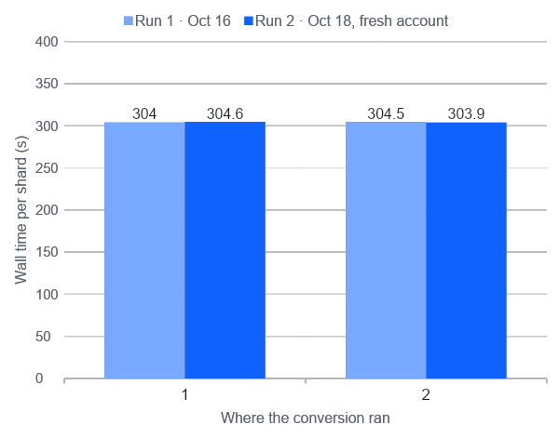
Result: runtime and correctness
No slowdown, and the same dataset from both modes, in both runs
1.00
runtime ratio in both runs, storage node / baseline
Which mode was faster flipped between runs, so the gap is noise. CPU-bound: 301 s converting vs. under 2 s to publish
Identical
output from both modes, byte for byte, in each run
stats.json compared as canonical JSON (its key order varies)
39 / 39
episodes · 9,829 frames · VERIFY OK
first and last frames decoded by LeRobot's loader, all 3 cameras
Notes:
Moving the work did not make it slower. The baseline took 304 seconds, and the storage machine took about the same, in both runs. In fact, the faster one switched between the two runs, so the difference is just noise. That's what we expected, because this conversion is limited by computing, not by the network. It spends about 300 seconds computing, and only about a second moving data. So we save network traffic at the same speed, which is exactly what the proposal asked for. And the output is identical in both modes, with all 39 episodes verified.

Slide 11
Limitations and next steps
What this result does not show yet, and what Demo 3 adds
LIMITATIONS
DEMO 3 · 11 / 16
One storage node: every input is local by construction, so this is the best case
This converter is CPU-bound, so locality saves bytes but not time
Loop-file OSDs share one disk: storage throughput is not representative
Several storage nodes on Kubernetes with Rook
Jobs submitted through a serverless API
Dependency-aware placement: run where the inputs are, fetch the fewest missing bytes
This baseline rerun on the multi-node setup
≈ 2.1 TB
would cross the network to convert all of DROID's 1.7 TB RLDS release with separate compute (estimated from shard 2, not measured)
Notes:
A few limitations. With only one storage machine, every input is already local, so this is the best case. Our converter is limited by computing, so moving it saves bytes but not time. And our storage disks are files on a single drive, so we don't measure disk speed. For Demo 3, we'll add several storage machines on Kubernetes with Rook, let people submit jobs through a serverless API, and add our first placement policy, which runs each job where its inputs are. Then we'll rerun this same baseline on that setup. For all of DROID, separate compute would move about 2 terabytes.

